Slide 1
Enriching the greening of industry literature with issue life cycle theory and a triple embeddedness framework
Mapping the Forces of Inertia in an Evolutionary Perspective: Air pollution, technical innovation and the American car industry revisited (1943-1985)*
Caetano C.R. Penna (c.penna@sussex.ac.uk)
Presentation for the Energy and Innovation Systems meeting
Organized by The Other Canon Foundation
November 25th
Voksenåsen
Oslo, Norway
*based on article by Penna & Geels (2010), with elements from Geels (2010)

Slide 2
Research project
‘Destabilisation of sociotechnical regimes as the key to transitions towards sustainability’
  The present literature focuses on green options that break through and replace existing sociotechnical regimes.
  The project turns the analytical focus upside down, seeing the destabilisation and decline of existing regimes as the key to transitions.
    The ‘destructive’ side of ‘creative destruction’?
  Funded by ERC, led by Prof. Frank Geels:
    Bruno Turnheim (coal industry);
    Caetano Penna (car industry).

Slide 3
Analytical puzzle
Puzzle
To conceptualize how ‘green’ issues gather momentum and create pressures that stimulate industry actors to reorient their regimes (e.g. by engaging in radical innovation): how is industry inertia overcome?

Slide 4
Developments in the greening of industries literature
First period (1960s-1990)
Environmental regulations seen as additional costs to business:
‘Resistant adaptation’ (compliance) strategies.
Second period (1990-2000)
A
How to move beyond compliance?
a) Determinants of corporate greening;
b) Phase models of corporate greening.
Third period (2000-2010)
Broader multi-dimensional understandings:
Blend of social and technical elements is distinctive for environmental issues.
“What is still clearly missing is synthetic research orientation and general models and theories that could be used for framing the ‘big picture’ and the ‘big questions’ of corporate greening.”
(Kallio and Nordberg, 2006:446)

Slide 5
Towards an expanded evolutionary perspective
“…evolutionary theory should coherently embrace an ‘embeddedness’ view of organizations, whereby the latter are not simply efficient solutions to informational problems arising from contract incompleteness and uncertainty, but also shape the ‘visions of the world’, interaction networks, behavioral patterns, and the identity of agents”.
(Dosi and Marengo, 2007:491)

Slide 6
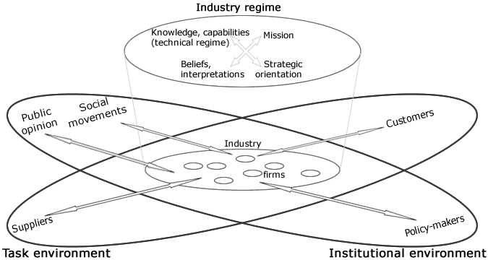
Industry? Triple embeddedness framework
A framework of industry dynamics
Source: Geels (2010:19)

Slide 7
Industry regime
Industry regime: industry-specific institutions that mediate interactions with external environments:
Capabilities and technical knowledge, which are resources for the development and production of technological products;
Identity and mission, which signal the industry’s societal purpose and business domain;
Beliefs and cognitive frames, which mediate managerial interpretations of signals, opportunities, and pressures from external environments;
Strategic orientation, which refers to industry attitudes and structural relations regarding external environments and industry-internal competition.

Slide 8
Industry inertia: lock-in and path dependence
  The set of deep structural elements as lock-in mechanisms: path dependence and incrementalism.
  Technical capabilities can turn into core rigidities, which limit what firms can do;
  Cognitive routines and mental models may blind actors to developments outside their focus (Nelson and Winter, 1982);
  Mission and identity are difficult to change because they refer to taken-for-granted beliefs that actors have about themselves and their role in society;
  Strategic orientations are stabilized by structural relations to existing markets, with firms listening primarily to established customers (Christensen, 1997).

Slide 9
Greening? Issue life cycle dynamics
The issue (attention) life-cycle
Source: Wartick and Mahon (1994, p. 301)

Slide 10
The greening of industry as an issue life cycle dynamics with industry evolution
Our model assumes that concerns about environmental issues emerge in the institutional environment, gradually build up pressure via public opinion and policy, and then spill over to the task environment and the industry regime...
Phase 1
Problem definition and framing struggles
Phase 2
Rising public concerns and defensive industry responses
Phase 3
Political debates and defensive hedging
Phase 4
Political regulations and diversification
Phase 5
Spillovers to task environment and strategic reorientation
In each phase technology/innovation is used by industry actors for different purposes: (1) R&D; (2) incremental innovation; (3) exploration of alternatives; (4) diversification towards radical innovations; (5) new technological base

Slide 11
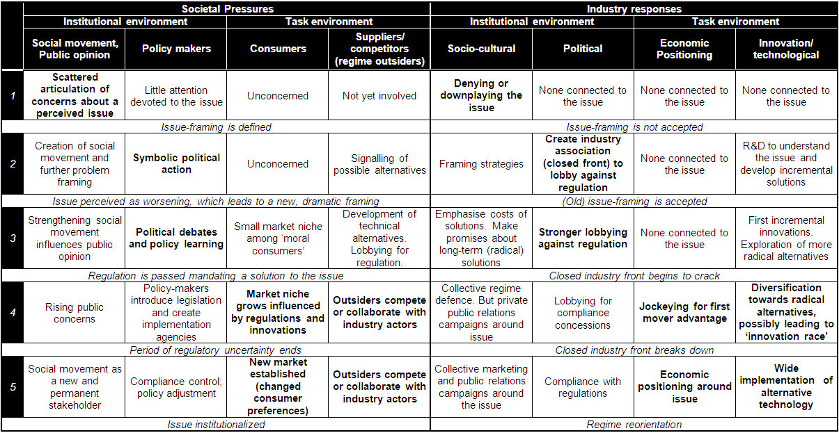
An ideal-typical pattern of issue evolution
Pressures and responses in each phase of the ideal-typical pattern of issue evolution

Slide 12
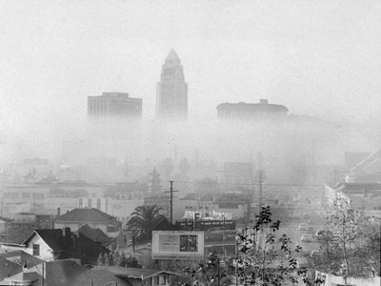
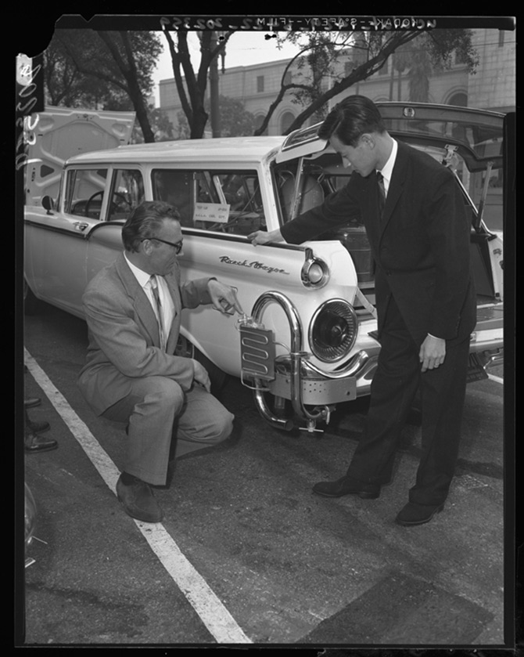
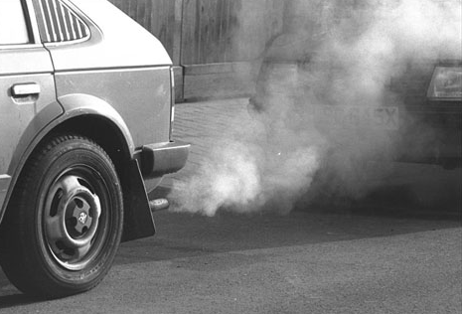
Longitudinal case study: Air pollution, technical innovation, and the American car industry (1943-1985)
Source: University of Southern California Digital Library and Los Angeles Times photographic archive, UCLA Library

Slide 13
Air pollution case: The issue-attention life cycle vs. the Big Three’s patenting activity
 | Attention | Attention (lag 1) | Attention (lag 2) | Attention (lag 3) | Attention (lag 4) | Attention (lag 5)
Patents | 81.24%** | 81.27%** | 81.48%** | 87.29%** | 92.31%** | 90.89%**
  Data sources: Archive search in newspapers (Los Angeles Times, New York Times, Wall Street Journal and Washington Post), key-words “air pollution” and smog and
  Google Patents search; keywords: “emission control”; “exhaust emission”, “catalyst”, “catalytic”; assignee : GM or Ford or Chrysler
  Obs.: Data is normalized by subtracting from each value the sample mean and then dividing by the sample standard deviation.
  ** Correlation (Spearman’s Rho) is significant at the 1% level (2-tailed).

Slide 14
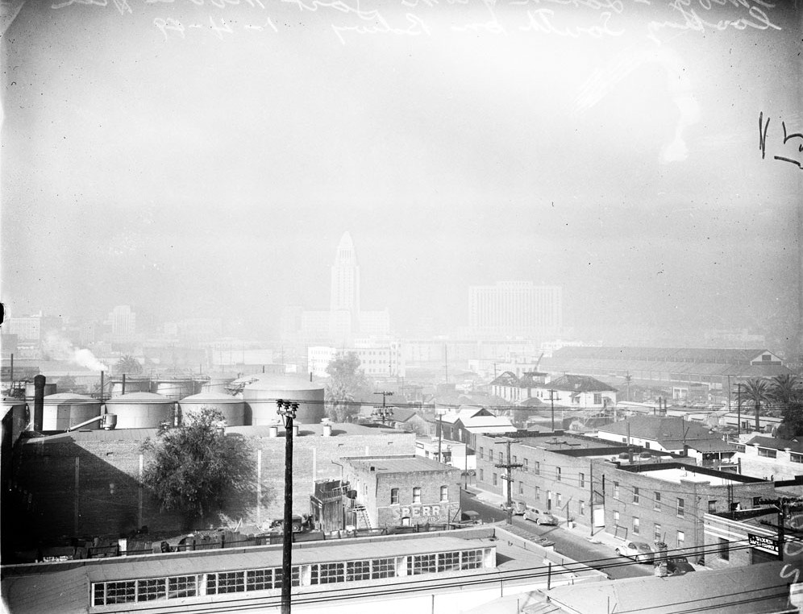
Case study – Period 1: Issue emergence and sensemaking attempts (1943-1953)
Smog in downtown LA, 1948
Source: University of Southern California Digital Library
Severe smog events in California
Public concern with occasional demonstration
Symbolic political action
Sensemaking efforts
Initial blame to stationary sources
Regime actors
unaffected by the issue

Slide 15
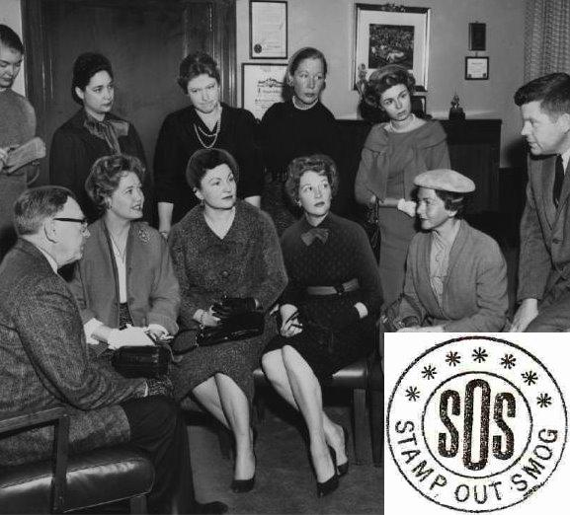
Case study – Period 2: Policy learning and defensive industry responses (1953-1960)
Source: Jacobs and Kelly (2008:192)
Stamp Out Smog meets with public officials
Formation of first environmental groups: spillovers from public opinion to policy
Policy learning and initial Federal involvement
Industry acknowledging the issue, but reframing attempts
Cooperative R&D programme: defensive response within regime

Slide 16
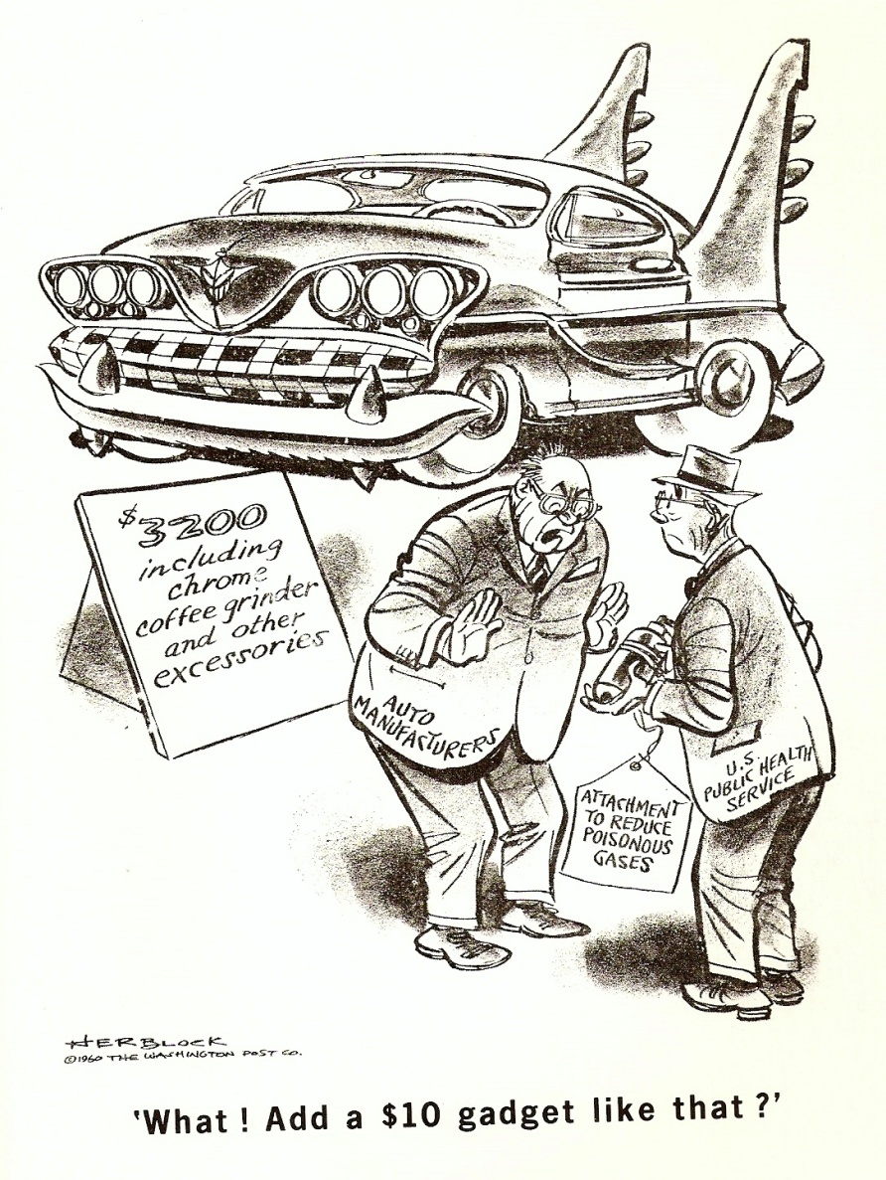
Case study – Phase 3: Increasing public concern, early legislation and industry delay (1960-1970)
Cartoon mocking the reluctance of the car industry to install control devices
Growing scientific understanding: ‘health hazardous’ framing
Social and political frustration: interaction with safety issue
Strategies to slow down progress on air pollution legislation: cost and unfeasibility argument;
promises of prototypes
Source: Washington Post, reprinted in U.S. Department of HEW (1966:3)

Slide 17
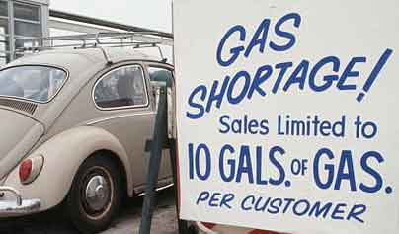
Case study – Phase 4: Tough legislation and resisted implementation (1970-1977)
Public attention devoted to air pollution (yearly number of articles – selected national newspaper
Peak in public attention to air pollution: Earth Day One
Passage of the Clean Air Act of 1970 and creation of EPA
Interaction with fuel efficiency issue
Regime actors fight standards,
while speeding up innovative effort
GM’s departure from industry front: new product champion, but pushing for delays (catching-up with suppliers)
Data source: Newspapers’ digital archives
Shifting consumer preferences in reaction to the oil crisis
Source: Google images

Slide 18
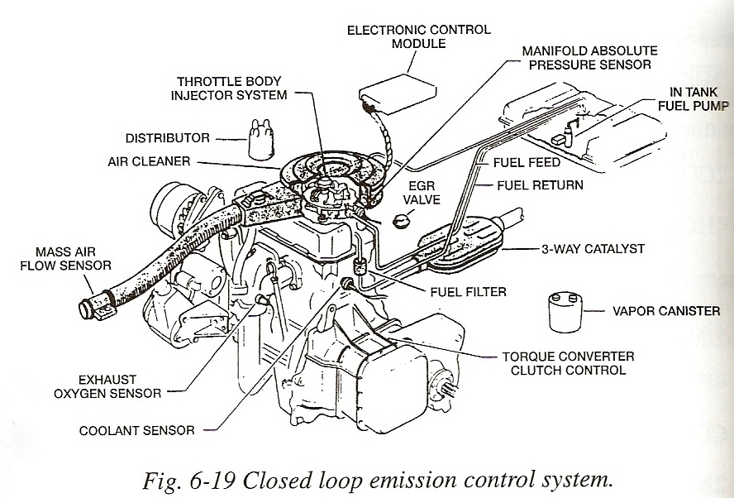
Case study – Phase 5: Industry fightback, implementation delays, and institutionalization (1977-1985)
Decline in public attention to air pollution
Postponement of standards in 1977
Financial trouble: industry rescue plan
Industry draws on its economic power but is unable to secure complete abolishment of legislation
Environmentalism revival with Reagan
Three-Way Catalytic (TWC) converters phased-in
GM’s closed loop emission control system with TWC
Source: Mondt (2000)

Slide 19
Discussion: technological change
Technological change in four steps:
  Investing in R&D (with resistance & as framing strategy);
  Tinkering with engine technology (‘voluntary’ action: political strategy);
  Simple add-ons (incrementalism)
  Complex add-ons and architectural change of engine (more ‘radical’ innovation)

Slide 20
Discussion: sources of inertia and how they were overcome
Denial (belief system) by industry undermined by scientific research and severe smog episodes (sense of urgency promoted by media);
Defensive industry response, incremental change (technical regime): cracking the closed industry front → competition with suppliers (for catalytic converter market) and outsiders (e.g. engine innovations by Japanese firms) and heightened incentives to increase rivals costs (because of regulatory commitment by EPA);
Lack of consumer demand (strategic orientation): market for catalytic converters created via technology forcing policy;
Industry’s economic problems (affecting its ‘mission’) leading to concerns about over-regulation: institutionalized environmental movement.

Slide 21
Regime vs. System transition?
The influence of intensity and diversity of values and interests on an issue’s development path
Source: Bigelow et. al, 1993:27
Even if the air pollution case was fairly ‘simple’ in terms of intensity and diversity of values and interests, it was a very complex and long greening process.
In cases involving system transition and technological discontinuities, it is likely that resistance will be more intense and issue evolution more complex.
But we expect that our analytical framework will be useful for studying contemporary ‘greening of industry’ processes.

Slide 22
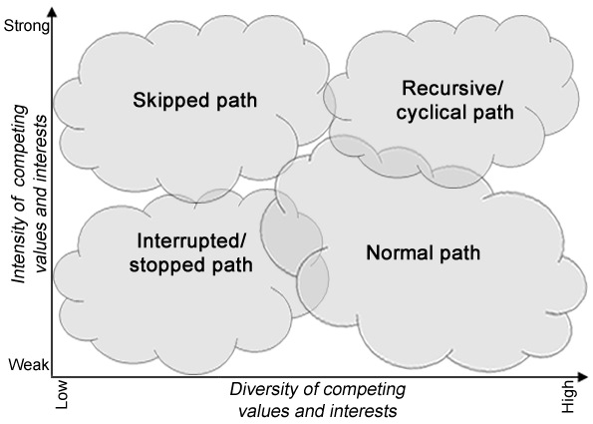
Regime vs. System transition?
The influence of intensity and diversity of values and interests on an issue’s development path
The air pollution case was fairly ‘simple’: normal path, but very complex and long greening process.
Cases of system transition and technological discontinuities: resistance will be more intense and issue evolution even more complex.
Proposed analytical framework should still be useful.
Source: Based on Bigelow et. al, 1993:27

